Slide 1
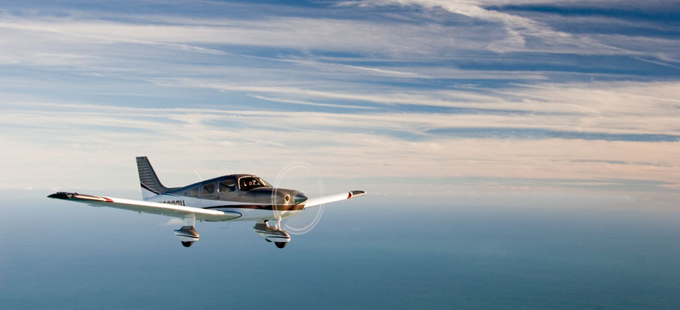
Descending

Slide 2
Housekeeping
60 minutes
Emergency exit, toilet, kitchen

Slide 3
Aim
To outline the techniques and procedures used in the PA-28 in
The glide descent
The cruise descent
The approach descent

Slide 4
Motivation
Learn how to handle the aircraft in a coordinated and safe manner during a descent.
With a high competency in the descending configurations, greatly improve the comfort and safety of passengers as well as improving the efficiency of the aircraft.

Slide 5
Overview
Objectives
Revision
Definitions
Types of descent
Forces acting in a descent
Factors affecting a descent
Application
Airmanship & TEM
Summary
Objectives – revisited

Slide 6
Objectives
At the end of the briefing, you will be able to, from memory and without mistake:
Explain the balance of the four forces in a gliding descent
State the effect of increasing weight on descent performance
State the effect of extending flaps on descent performance
Explain how to enter, maintain and exit from a descent

Slide 7
Revision
Types of climb
Forces acting in a climb
Factors affecting the climb

Slide 8
Definitions
Glide
A stabilized descent with power set at idle rpm. (or engine failure).

Slide 9
Definitions
Rate of descent
The rate, in feet per minutes, at which an aeroplane descends – a measure of vertical speed.
Angle of descent
The gradient of the aeroplane’s descent.

Slide 10
Types of descent
Glide descent
Power off, no thrust
Cruise descent
Power used to control RoD, usually 500fpm
Approach descent
Power used to control RoD, landing configuration

Slide 11
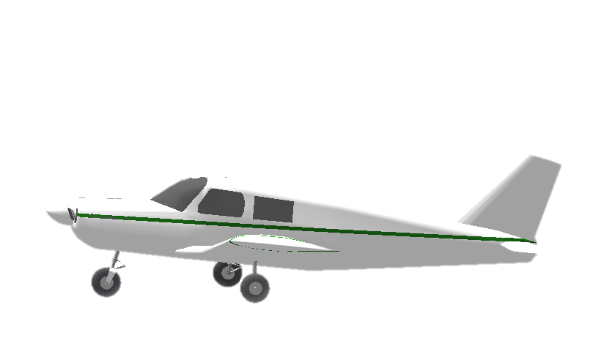
Lift
Straight & Level
Drag
RAF
Thrust
Weight
Notes:
Only drag, lift and weight will act on the aeroplane when power is totally removed.
If power is reduced to idle when the aeroplane is in S & L, the drag will be unbalanced and, if height is maintained, the aeroplane will decelerate.
To maintain the airspeed when the thrust is removed, the nose must be lowered in order for the glide to commence.

Slide 12
Lift
GLIDE
Drag
Forward Component of Weight
RAF
Weight
Lift < Weight
Thrust + FCW = Drag

Slide 13
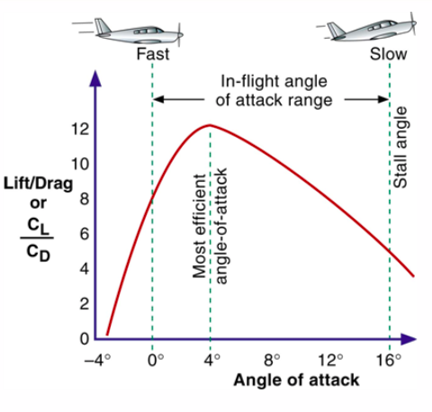
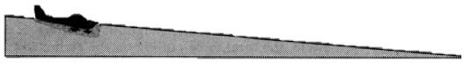
Glide descent
What we want: maximum glide distance with the minimum altitude lost.
Best range in still air is achieved at an angle of attack producing the best lift/drag ratio.
L/D – 12:1
1000ft
12000ft = 2 nm
Notes:
The angle which gives the best range in still air is achieved at an angle of attack producing the best lift/drag ratio.
Compare with 10:1

Slide 14
Glide descent
Best lift/drag = minimum drag
Best range achieved at best lift/drag
We measure AoA with airspeed
Airspeed at minimum drag (or best lift/drag) = best glide speed

Slide 15
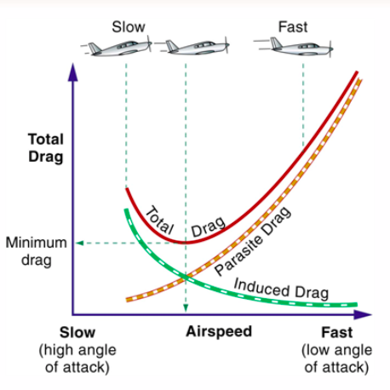
Glide descent
73 kts

Slide 16
Factors affecting a descent
Airspeed
Thrust
Weight
Flap
Wind

Slide 17
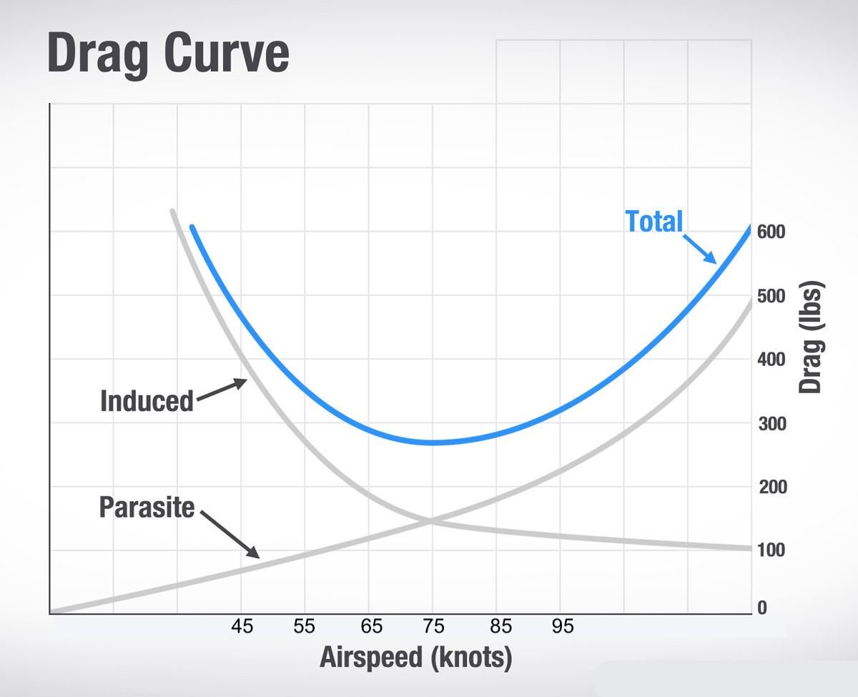
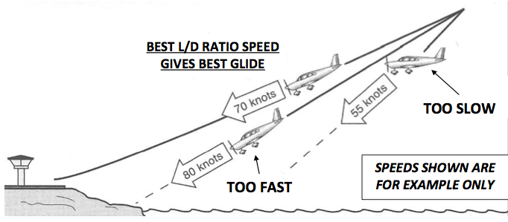
Factors affecting a descent – Airspeed
An aeroplane will glide the maximum distance when it is flown at an airspeed corresponding to best L/D ratio.

Slide 18
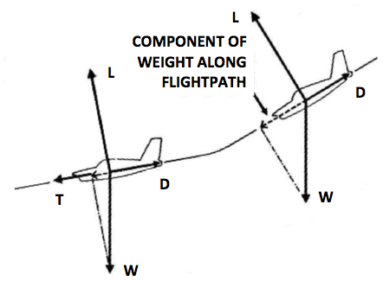
Factors affecting a descent – Power
Increase in power will allow us to raise the nose as we no longer need that FCW to balance drag.
This will reduce both angle and rate of descent, range will be increased.
Notes:
Power is used to overcome drag
Increase in power will allow us to raise the nose as we no longer need that FCW to balance drag
This will reduce our angle of descent and our rate
Range will be increased

Slide 19
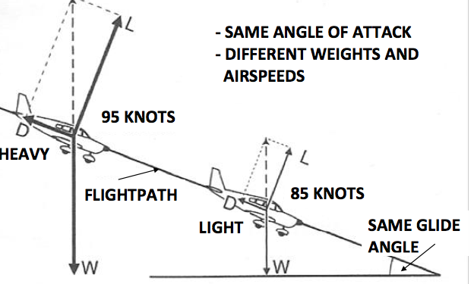
Factors affecting a descent – Weight
Increase in weight increases the FCW.
This will increase the speed, therefore rate of descent will be increased, angle will remain the same.
Notes:
Increase in weight increases the FCW
This will increase the speed, therefore rate of descent will be increased however, angle will remain the same
Endurance will be less with an increase in weight

Slide 20
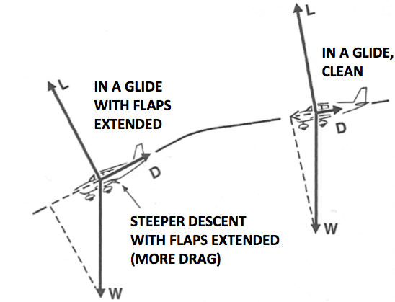
Factors affecting a descent – Flap
With the increase of drag, we will no longer be flying at best L/D ratio.
Increase both angle and rate of descent, range will be reduced.
Notes:
Although flap increases lift, it also increases drag.

Slide 21
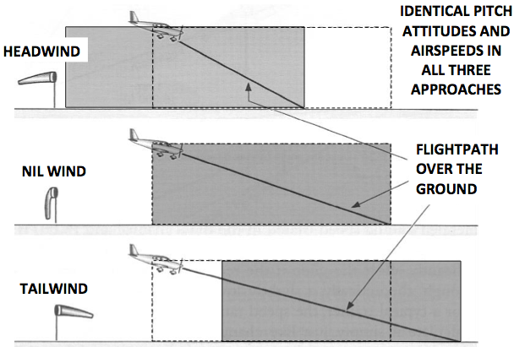
Factors affecting a descent – Wind
At a constant airspeed, the rate of descent is unaffected by the wind.
The angle of descent is increased when descending into a headwind and reduced when descending with a tailwind

Slide 22
Factors affecting a descent – Recap
Factor | Angle of Descent | Rate of Descent
Airspeed
Flaps
Power
Headwind
Tailwind
Weight
⬆
⬆
⬆
⬆
⬇
⬇
⬆
Same
⬇
Same
Same
⬆

Slide 23
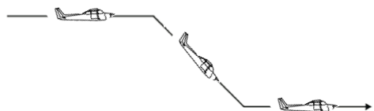
Application
Power
Attitude
Speed
Trim
Attitude
Lookout
Attitude
Performance
PAST
Pre Entry Checks
engine should be warmed using a power setting of 2000RPM for 4 seconds every 1000ft of descent.
Reference point selected
Carburetor heat as desired
Mixture full rich
Temperatures and pressures checked
Lookout
ALAP
CCHAT
Change
Check
Hold
Adjust
Trim
PAST
Power
Attitude
Speed
Trim

Slide 24
Application
Power setting Warrior PA28-161
PAST | Glide | Cruise | Approach
Power | Idle | 2100 rpm | 1500 rpm
Attitude | 1/3 ground | 1/3 ground | 1/2 ground
Speed | 73 kts | 95 kts (500fpm) | 75 kts (2 stages flap)
Trim and balance

Slide 25
Airmanship
Lookout
Engine considerations.
Minimum Altitudes (CAR 1988 REG 157) & Situation Awareness.
Populated areas - not below 1,000ft AGL
Non-populated areas – not below 500ft AGL

Slide 26
Threat and error management
Threat | Error | Management | UAS
Barotrauma |  | Don’t fly if unwell Use moderate RoD | Pilot incapacitation
Low power operations | Long periods of idle power |  | Loss of engine power Fouled spark plugs
Terrain | Poor situational awareness | Maintain 500ft/1000ft AGL Awareness of terrain
High RoD with
blocked nose
Warm engine every 1000ft
Use carby heat
Descent below minimums

Slide 27
Summary
Types of descent and how to achieve it
Forces acting in a descent
Factors affecting a descent

Slide 28
Objective – revisited
Explain the balance of the four forces in a gliding descent
State the effect of increasing weight on descent performance
State the effect of extending flaps on descent performance
Explain how to enter, maintain and exit from a descent

Slide 29
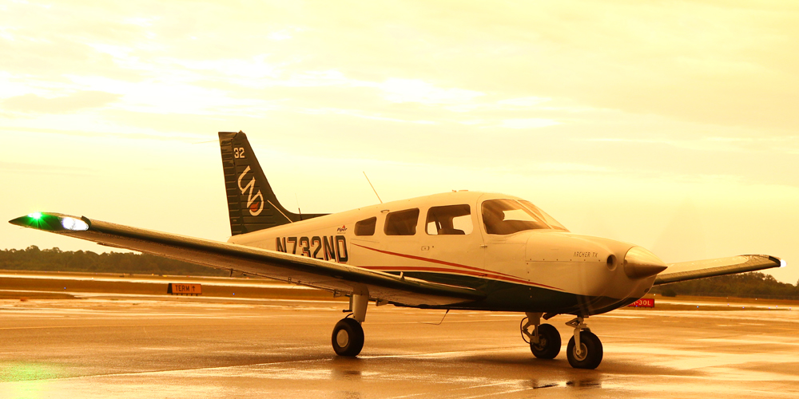
The end

